Slide 1

CSCE 240 Chatbot
Joshua Braun

Slide 2
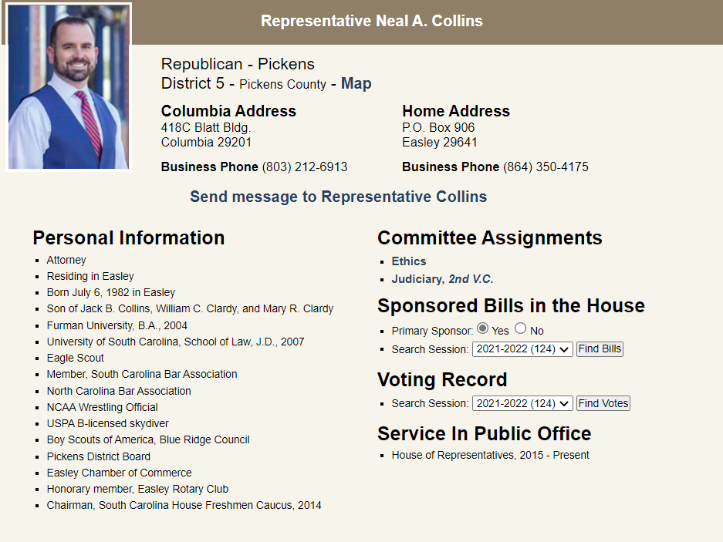
Scope:
I chose district 5 representative Neal A. Collins
My programming language was C++ and I used Eclipse
The information from the website was converted into a text file

Slide 3
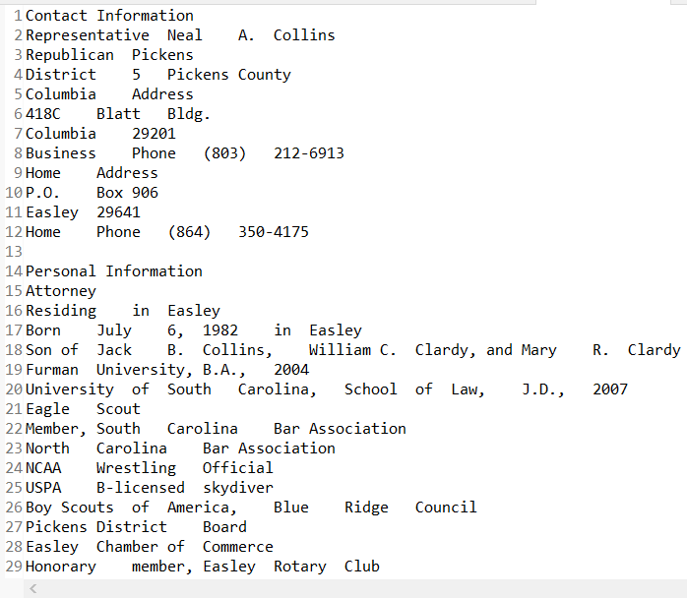
Data:
The data that is available is:
The representative’s name
Contact information
Personal information
Committee assignments
Sponsored Bills in the house
The voting record
And his service in public office
The user can also access information about past chats, such as user utterances, system utterances, and time taken

Slide 4
Code Organization
PA1: For this project, the information was put into a text file and my program edited/formatted it and counted the total characters and words
PA2: For this project, I made a method that would take a string as input and search the output file from PA1 for a matching string. If found, it would return the following lines until a white space was reached. I also had a method that would split a string at a semicolon so that more specific searches could be done
PA3: I created an infinite loop that constantly took user input until the user typed quit. If they typed something else my program would call a HandleQuery method that would match what they typed to phrases my program knew
PA4: I changed my HandleQuery method to a Match method that would compare the words in two statements and see how many were the same
PA5: I added a method that creates a file with the current date and time. I also had variables for all the statistics of a session that would then be appended to the end of the chat file. Lastly, I added command line arguments so that information from previous sessions could be accessed.

Slide 5
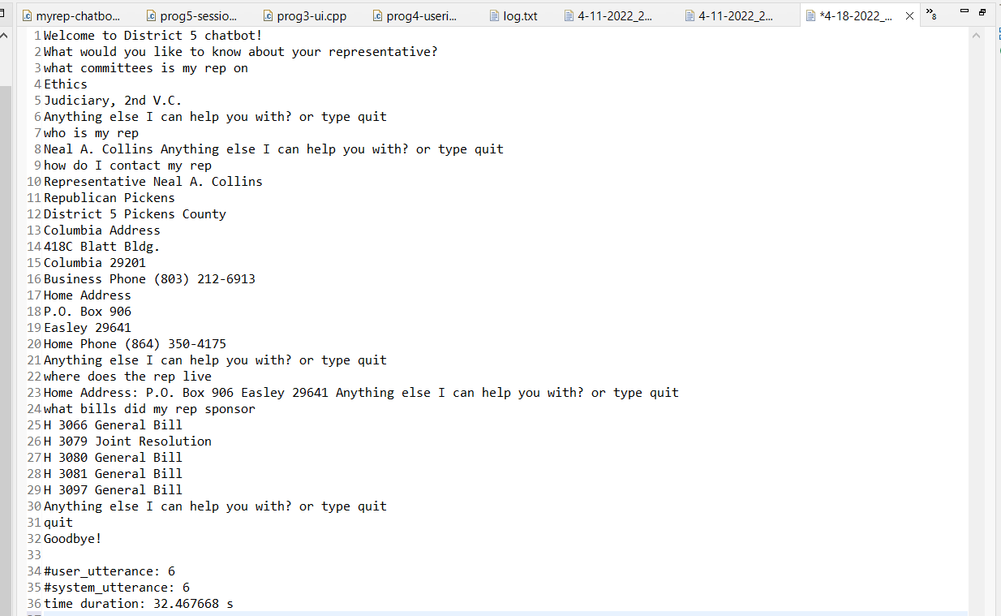
Queries Snapshot:
Video Link:
CSCE240/mychatbot.mp4 at main · jdbraun1/CSCE240 (github.com)

Slide 6
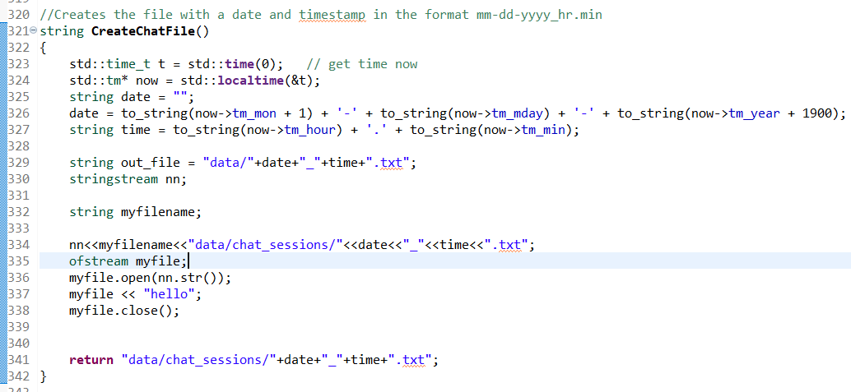
Experience:
Implementing the chatbot was difficult
The method for getting the info was one of the hardest and most time consuming to get to work correctly
Also, the method for creating a chat file with the current date and time was complicated because all my other methods had to edit the file that was created
Collecting the data about specific chats from the CSV file also proved challenging and required a lot of code
For testing most of the time if I got an error or incorrect result I would put a cout into my program to see how far the program was getting and where the error was coming from. I also conducted a lot of research on coding forums to find working examples of code
A lot of times I would code my methods in a separate project to see if it worked and then add it into the main project afterwards

